Slide 1
IT1762
Data Structures and Algorithms
Topic 5A
Strings

Slide 2
OBJECTIVES
Learn how to handle strings in C#
  Capture a string.
  Processing a string.
  Compare 2 strings.
  Substring in a string.
  Useful properties of strings
    eg. Length
  Relationship between string and character (char) array.
‘S’
‘P’

Slide 3
String Class
The string type is used to handle many characters in C#.
eg. string name = “Graham Green”;
To handle one or single character, use the char data type.
eg. char gender = ‘M’;
The string data type is IMMUTABLE – the text of the string cannot be modified after it has been created.
eg. string name = “Michael Caxton”;
name[0] = ‘Z’; //compile error
Methods that modify a string value actually returns a new instance of string that contains the modification.

Slide 4
String
Methods, Properties, Operators
Bracket [ ] – extract a single character from a string.
Insert – method to insert characters into a string.
Length Property – returns the length of a string or the number of characters in a string.
Concat – method to join strings together.
Equals – method to compare 2 strings.
  (can also use == and != operators)
  (cannot use < , >, <=, >= for strings)
Strings can be operated on by methods
  Amending string methods
  Conversion string methods
  Examining string methods

Slide 5
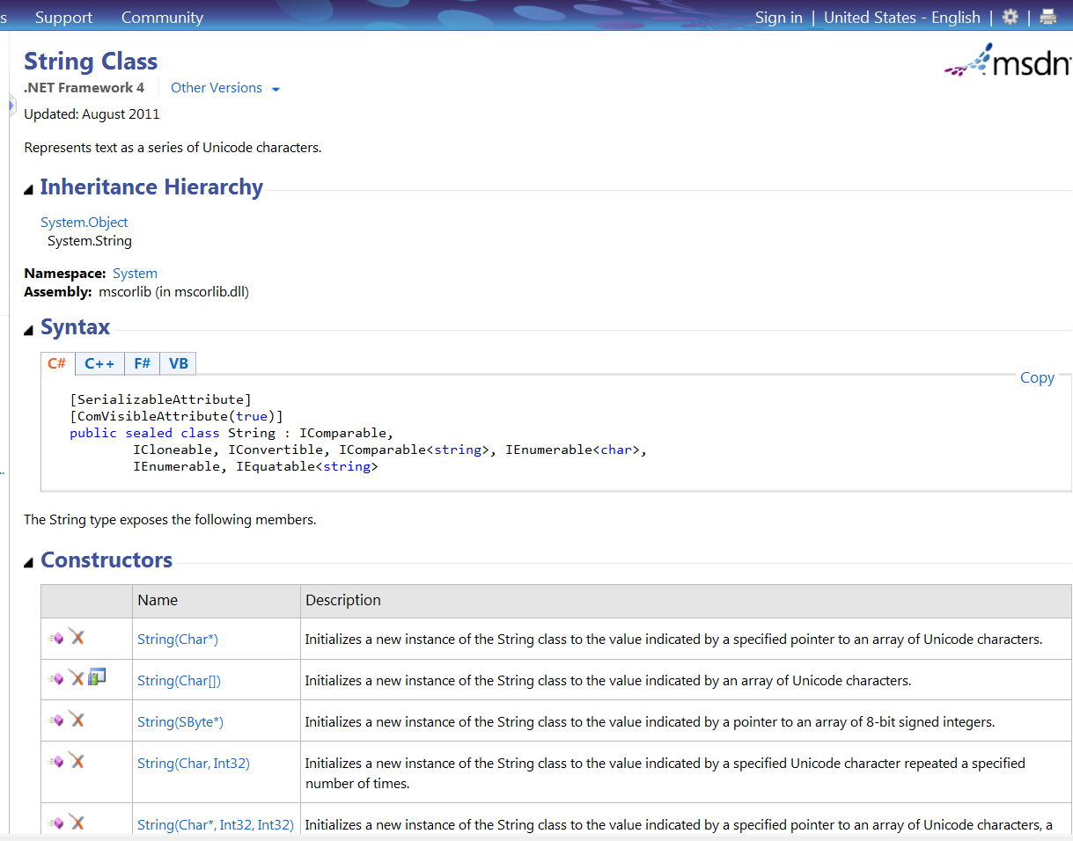
String
Methods, Properties, Operators
For a full list of methods & properties of String, visit MSDN website:
http://msdn.microsoft.com/en-us/library/system.string.aspx
MUST Visit the MSDN website to find out more about String classes

Slide 6
Example – Bracket [ ]
A string is stored as a character array.
The square brackets [ ] returns specific characters of a string.
[ ] contains a integer. Its range is between 0 and the (string Length -1).
The length of the string is 7(the number of characters it contains)
string address = “180 AMK”;
MessageBox.Show(“Display second character :” + address[1]);
// display 2nd character of address – ‘8’
char temp = address[4];
// stores 5th character ‘A’ into temp
address[2] = ‘9’;
Character :
1
8
0
A
M
K
0
1
2
3
4
5
6
INDEX
// not valid as string is immutable

Slide 7
  Amending string methods
  Replacing String
You can replace a string value with another string by using the “= “ operator (assignment).
string Address = “33 Kent Road”;
string tempAddress = “33 AMK”;
Address = tempAddress;
MessageBox.Show(“result is ” + Address);
//33 AMK

Slide 8
Amending string methods
Joining 2 Strings
Concat method joins 2 strings together.
Syntax:
String.Concat( string1, string2);
Example:
string Surname = “Clinton”;
string Lastname = “Bill “;
string Name = String.Concat( Lastname, Surname);
//BillClinton
MessageBox.Show(“Name is ” + Name);
Concat method will create a new string after the method.
How about “+” ?

Slide 9
  Amending string methods
  Insert String
string s1 = “C is great”;
s1 = s1.Insert(2, “Sharp “);
// Insert “Sharp” at the specified position (ie. 2).
MessageBox.Show(s1);
// C Sharp is great
More Amending Strings methods:
Converts all letters in a string into lower-case or upper case letter
string1.ToLower();
string1.ToUpper();
Removes a given number of characters at a given position
string1.Remove(1,4) //starting position, number to remove
These methods create a new string rather than changing the original string

Slide 10
  Examining string methods
  Length Property
Returns an INTEGER value which is the number of characters in the string.
Syntax:
string Address = “33 Kent Rd”;
string Display = “”;
int AddressSize = Address.Length;
Display = “Number of characters is ” + AddressSize;
MessageBox.Show(Display);
//Address has 10 characters so Length
//will return value of 10.

Slide 11
  Conversion methods
  ToString method
Converts anything to a string type.
Example:
int age = 33, wholedollar = 2, centleft = 10;
string temp = age.ToString( );
//temp now contains “33”
//display integer values using labels
lbldollar.Text = wholedollar.ToString();
lblcent.Text = centleft.ToString();
More Conversion methods:
Convert.ToDouble
Convert.ToInt32
Convert.ToChar

Slide 12
Examining string methods
Comparing Strings
Can use == operator to compare if 2 strings are the same.
Returns True or False (bool type)
string label1 = “180 amk”;
string label2 = “180 amk ave 5”;
string label3 = “180 AMK”;
string label4 = “180 amk”;
bool result;
int result1;
result = (label1 == label2); // false result
MessageBox.Show(“result is ” + result);
result =( label1 == label3);
// false result – case sensitive
MessageBox.Show(“result is ” + result);
result = ( label1 == label4);
// true result, both strings are the same
MessageBox.Show(“result is ” + result);
result1 = string.Compare(label1, label3, true);
//true as case sensitive turned OFF and return integer 0 or 1
MessageBox.Show(“result is ” + result1);
// result1 is displayed as 0, both strings are the same

Slide 13
Examining string methods
Checking using Contains
Contains method to check whether a sub-string exists in it.
The Contains method returns a True or False.
string address = “180 AMK Ave 8”;
bool result;
//find out if address contains “AMK”
result = address.Contains(“AMK”);
// true result
MessageBox.Show(“result is ” + result);

Slide 14
  Examining string methods
  Substring and IndexOf
Substring
  Method copies a specified part of a string. E.g
    string string1= “position”;
    string resultstring=string1.Substring(2,3);
    // resultstring is “sit”, index at 2 and 3 characters
IndexOf
  Method Reports the index of the first occurrence of the specified string in string1. E.g
    string string1= “mississippi!”;
    int n=string1.IndexOf(“is”);
    // n is 1, index starts from 0

Slide 15
Summary
A string contains a sequence of characters
String can be declared and created by:
  string s= “Hello”;
Strings can be operated on by methods
  Amending string methods
  Examining string methods
  Conversion string methods
To get details of methods, refer to
  MSDN website

Slide 16
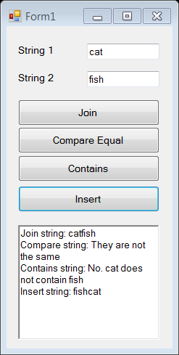
Practical 5A
Q1. Write a program which inputs 2 strings from text boxes and buttons.
When user clicks on:
Join button
Compare equal button
Contains button, check for string 1 contains any string 2
Insert button, it inserts string 2 at position 1 of string 1
Call the respective string method. Show the resulting string in a rich text box.
Here is a sample code to help you. Fill in the blanks.
private void btnJoin_Click(object sender, EventArgs e)
{
string s1 = txtString1.Text;
string s2 = txtString2.Text;
string result;
result = string. __________(s1, s2);
rtbResult.AppendText("Join string: " + ________
+ "\n");
}

Slide 17
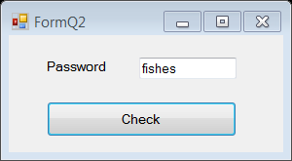
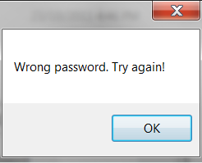
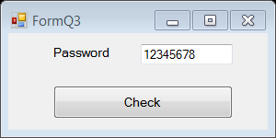
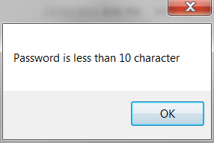
Practical 5A
Q2 Write an application to get user to enter a password. User clicks on Check button, the program checks the password string against “fish”. (HINT: use the = = operator or Equals method for comparison). Display appropriate error messages.
Q3 Write an application to get user to enter a password. User clicks on Check button, program checks if the password entered must be more than 10 characters. (HINT: use the Length property). Display appropriate error messages.

Slide 18
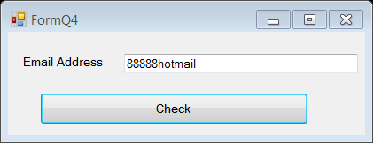
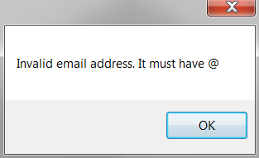
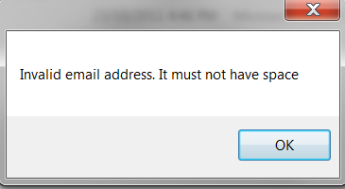
Practical 5A
Q4 Write an application to get user to enter his/her email address. Email address must NOT have spaces and MUST have a ‘@’ character. When user clicks on Check button, the program checks the entered email address and display appropriate error messages.
Display error messages for invalid email address

Slide 19
IT1762
Data Structures and Algorithms
End of
Topic 5A Strings

